Slide 1
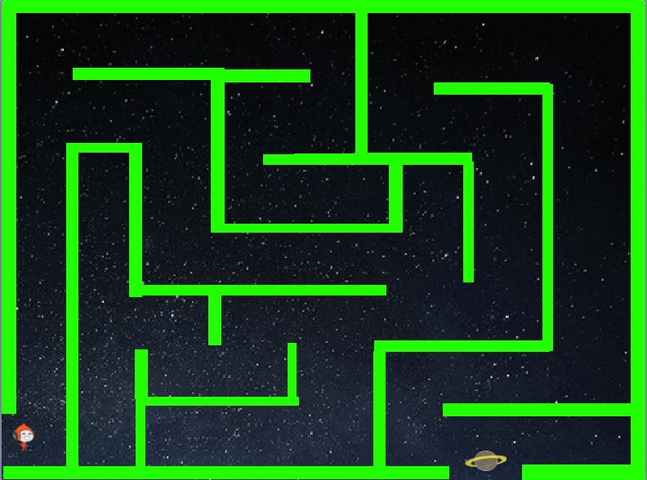
2D CONSOLE BASED MAZE GAME
Object Oriented Programming
Umm-e-Habiba Imran (048)
Zainab Idrees (048)
Submitted To: Sir Muhammad Siddique
Ma’am Saima Jawad

Slide 2
Project Overview
The project aims to create an interactive and engaging 2D maze game. It addresses the challenge of combining logical problem-solving with entertainment and provides an innovative solution that enhances user engagement through dynamic gameplay. Developed using C++ and leveraging ANSI escape codes for graphical enhancements, the project is designed to offer a visually appealing and intellectually stimulating experience.

Slide 3
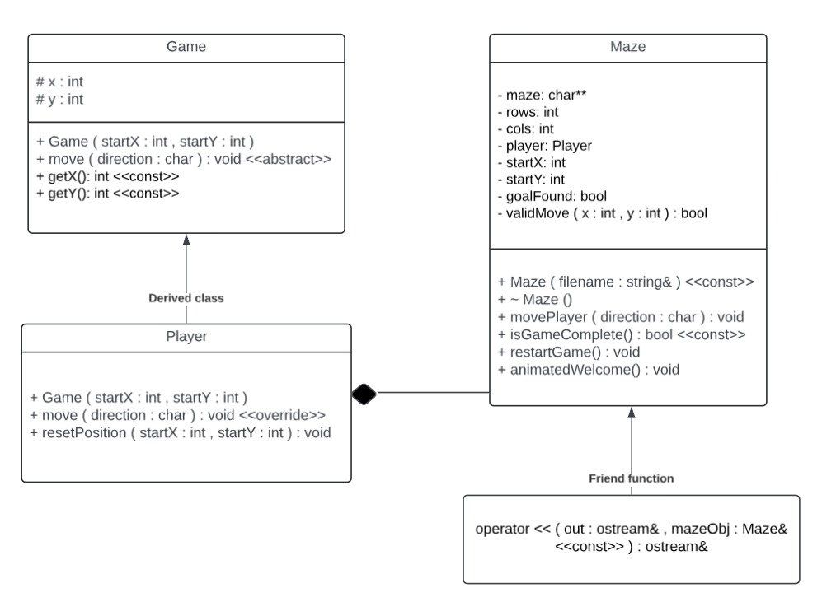
UML CLASS DIAGRAM

Slide 4
Key Components
.
CLASS GAME
- Encapsulates player coordinates (x, y).
- Contains virtual methods like move to be overridden by subclasses.
- Implements the move method to handle movement (w/a/s/d for directions).
- Provides methods like resetPosition for resetting the player’s position after invalid moves.
- movePlayer: Manages movement and validates moves.
- isGameComplete: Checks if the player reached the endpoint.
- restartGame: Resets player position and move count.
- Friend function to display the maze (operator<<).
CLASS PLAYER
CLASS
MAZE

Slide 5
Features
Movement through W, S, A, D
Difficulty: Easy, medium, Hard
Dynamic Maze Display
Goal Oriented Gameplay
Custom Welcome and Menu
Error Handling
Replay and Start Options
Move count and Time Tracking
Visual maze Solutions
Robust Termination
Integrate user input
Return to Home Options

Slide 6
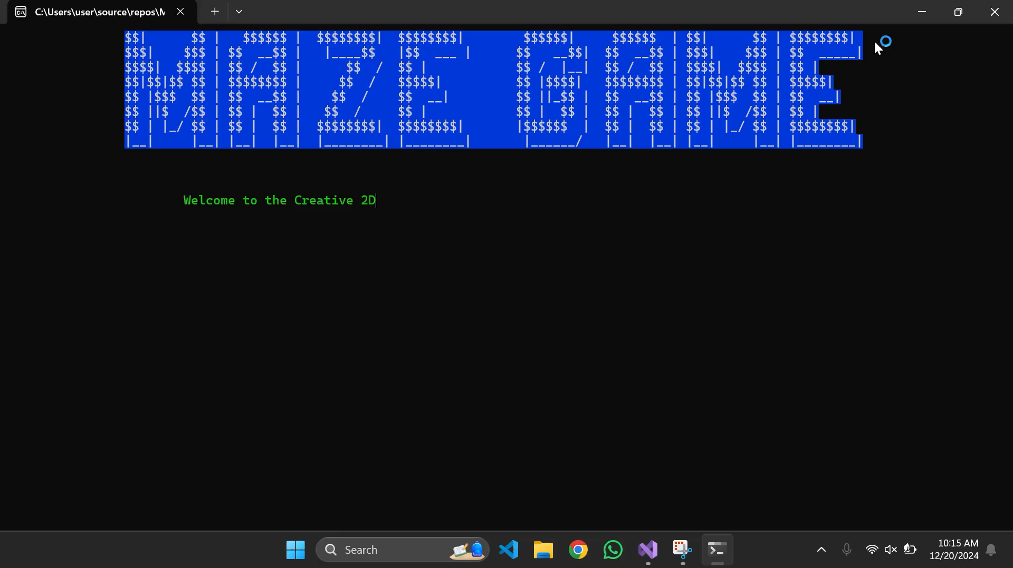

Slide 7
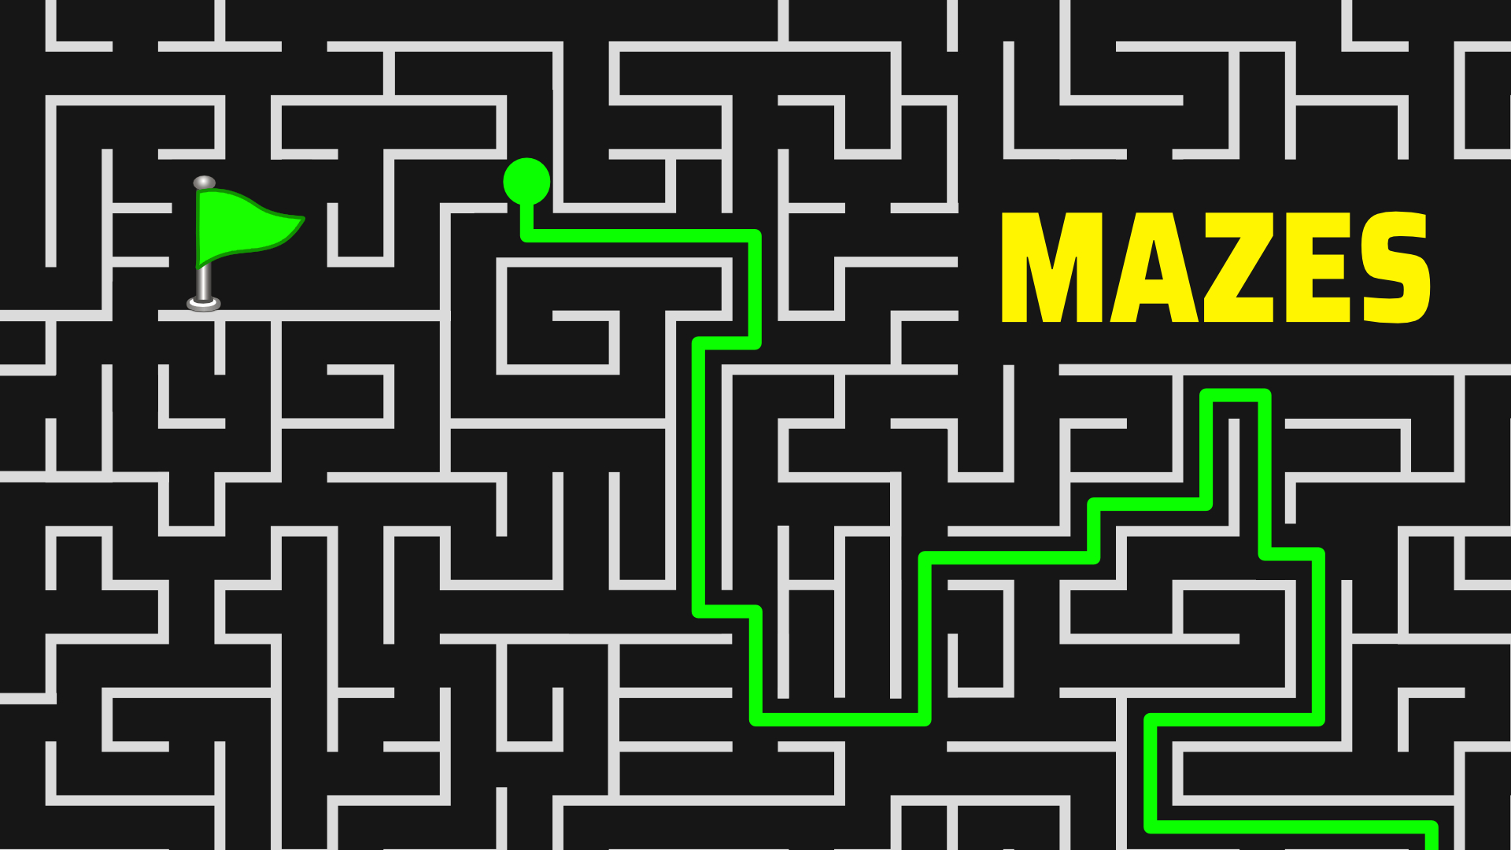
Thank you
.

